Slide 1
Particle Swarm Optimization
(PSO)
By: Saúl Alonso Nuño Sánchez

Slide 2
history
PSO was introduced in 1995 by J. Kennedy (sociology) & R. Eberhart (computation). 'Particle swarm optimization', Neural Networks, 1995. Proceedings., IEEE International Conference)

Slide 3
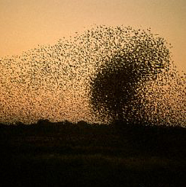

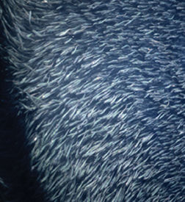
PSO
It is inspired by the behavior of insect swarms in nature or biological societies, where individuals share goals and exhibit both individual and social behaviors.

Slide 4
Operation
Particles are attracted to the food
Each particle remembers its closest position with respect to food
Particles share information with neighboring particles about what their closest position to the food has been

Slide 5
Idea:
The solutions have a position in the search space (the optimum has a position as well). The goal is for the solutions to explore the search space to reach the optimum of the problem. It is not known where the optimum is but it is known how far each solution is from the optimum.
* Assuming that there is an optimum and that it is unique.

Slide 6
Algorithm
At each instant of time t, each individual i has a position of (x_{i}^{t}) in the search space as well as an associated velocity (v_{i}^{t})
The size of x_{i}^{t} = v_{i}^{t} = d, the dimensions of the problem to be addressed.

Slide 7
The algorithm is an iterative process in each instant of time each particle:
Knows what has been its best position with respect to the target (local best).
It knows what has been the best position of its neighbors (global best).
The particle is attracted to both.

Slide 8
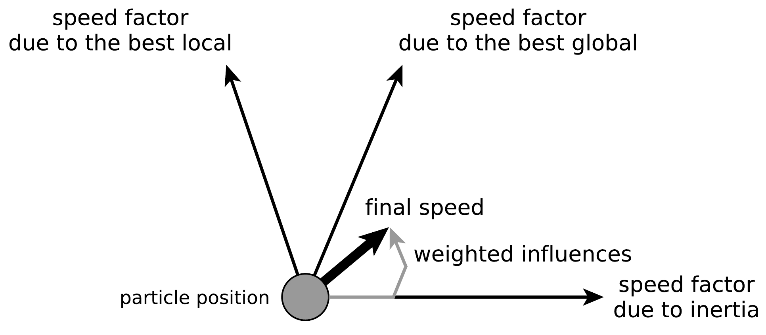

Slide 9
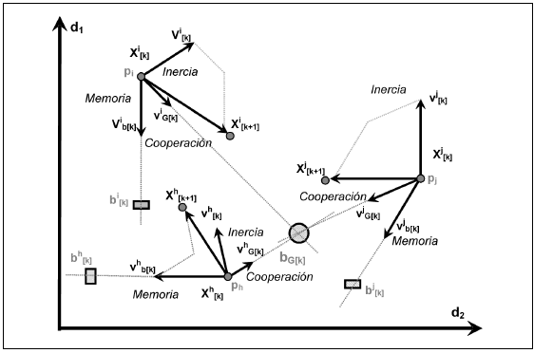

Slide 10
PSO: the algorithm
Particles update their position in the search space according to:
Inercia
Local Info.
Global Info.

Slide 11
algorithm
Randomly initialize the population of individuals (swarm) with initial velocity and position.
Repeat the following iterative process until a stop criterion is met:
Evaluate the suitability (fitness) of each particle.
Determine the best local solutions (p_{i}), for each particle, and global best (p_{g})
Update the position and velocity of the particles given the solutions in b)
The best evaluated particle is returned
Fitness value
...
Init
t=1
t=2
...
t=max_it

Slide 12
PSO parameters
The main parameters of PSO are: φ0, φ1, φ2 the type of neighborhood, number of solutions, stopping criterion.
Inercia
Local Info.
Global Info

Slide 13
PSO parameters
The main parameters of PSO are: φ0, φ1, φ2 the type of neighborhood, number of solutions, stopping criterion.

Slide 14
PSO parameters
If we do
with
Values of guarantee the convergence* of PSO
F. van den Bergh. An Analysis of Particle Swarm Optimizers. PhD thesis, University of Pretoria, Sudafrica, November 2001.

Slide 15
PSO parameters
About inercia:
One of the most commonly used methods is an adaptive inertia weight.
Set at the beginning φ₀ = w_{start}, and this value is decreased linearly over k iterations up to a value of φ₀ = w_{end}
Large values of φ₀ allow to move in larger steps while small values of φ₀ allow to intensively explore certain zones.

Slide 16
Advantages
Simple and extremely easy to implement method
Does not require specialized operators for the generation of new solutions
Allows "easy" control of how the search space is explored
Can be adapted according to the characteristics of the problem

Slide 17
Disadvantages
No general convergence analysis, there are only results for simplifications.
No guarantee to find the minimum
Has troubles with non-continuous problems

Slide 18
Possible variants
Add a repulsive force between particles.
Divide the particles into families and consider global maxima per family.
If the function trying to be optimized changes in time, i.e. in the case where it is a dynamic search.

Slide 19
What to do to maximize?
Modify the algorithm
Modify the objective function and constraints

